Slide 1
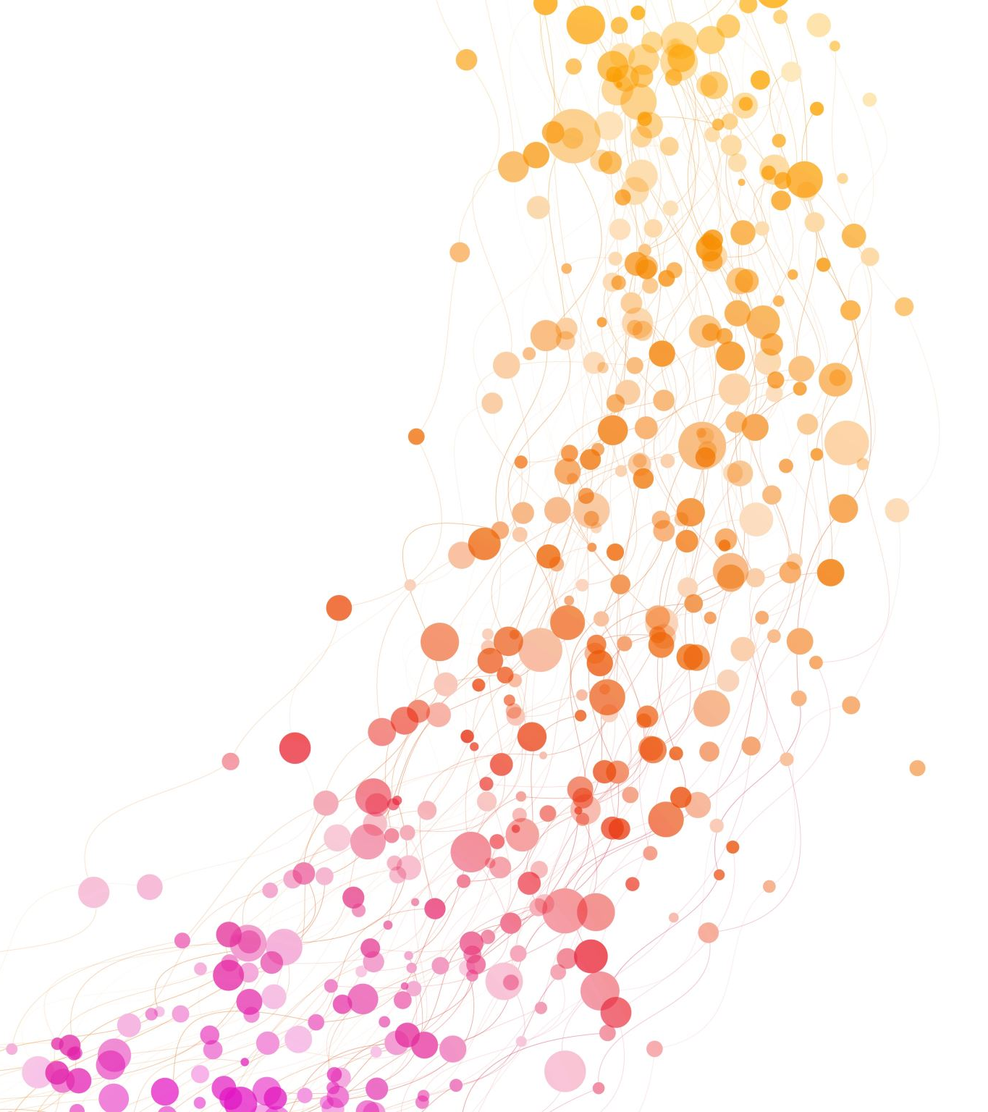
COST- Unit 5
Correlation

Slide 2
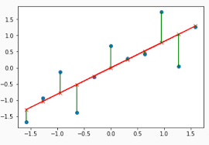
Revision
Correlation
Types of correlation
Residuals
Positive/Direct
Negative/Inverse
Residual = Y obs – Y est
Degree of relationship

Slide 3
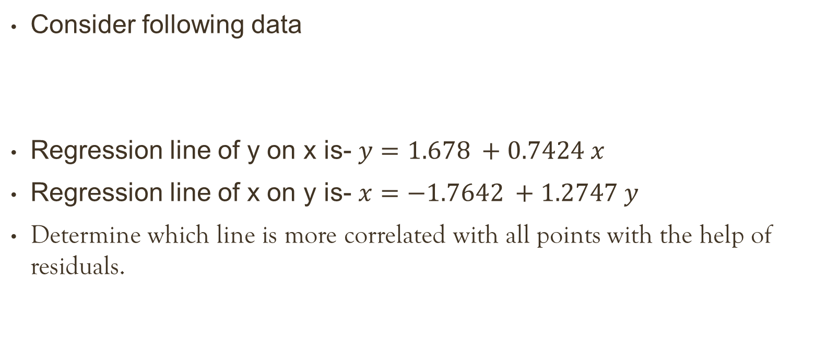
Question
Consider following data
Regression line of y on x is- $y=1.678 +0.7424 x$
Regression line of x on y is- $x=−1.7642 +1.2747 y$
Determine which line is more correlated with all points with the help of residuals.
X | 1 | 3 | 4 | 6 | 8 | 9 | 11 | 14
Y | 2 | 4 | 5 | 6 | 7 | 10 | 9 | 12

Slide 4
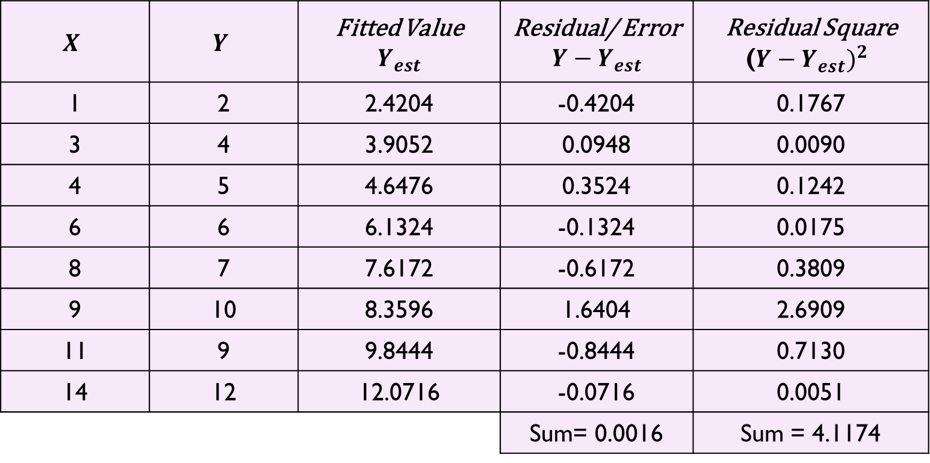

Solution
Regression line of y on x is- $y=1.678 +0.7424 x$
$$X$$ | $$Y$$ | Fitted Value $$Y_{est}$$ | Residual/ Error $$Y−Y_{est}$$ | Residual Square (${Y−Y_{est})}^{2}$
1 | 2 | 2.4204 | -0.4204 | 0.1767
3 | 4 | 3.9052 | 0.0948 | 0.0090
4 | 5 | 4.6476 | 0.3524 | 0.1242
6 | 6 | 6.1324 | -0.1324 | 0.0175
8 | 7 | 7.6172 | -0.6172 | 0.3809
9 | 10 | 8.3596 | 1.6404 | 2.6909
11 | 9 | 9.8444 | -0.8444 | 0.7130
14 | 12 | 12.0716 | -0.0716 | 0.0051
 |  |  | Sum= 0.0016 | Sum = 4.1174

Slide 5


Solution
Regression line of x on y is- $x=−1.7642 +1.2747 y$
$$X$$ | $$Y$$ | Fitted Value $$X_{est}$$ | Residual/ Error $$X−X_{est}$$ | Residual Square (${X−X_{est})}^{2}$
1 | 2 | 0.7842 | 0.2158 | 0.0466
3 | 4 | 3.3326 | -0.3326 | 0.1106
4 | 5 | 4.6068 | -0.6068 | 0.3682
6 | 6 | 5.8810 | 0.1190 | 0.0142
8 | 7 | 7.1552 | 0.8448 | 0.7137
9 | 10 | 10.9778 | -1.9778 | 3.9117
11 | 9 | 9.7036 | 1.2964 | 1.6807
14 | 12 | 13.5262 | 0.4738 | 0.2245
 |  |  | Sum= 0.0326 | Sum= 7.0701

Slide 6
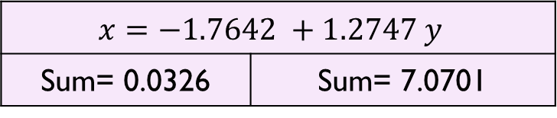
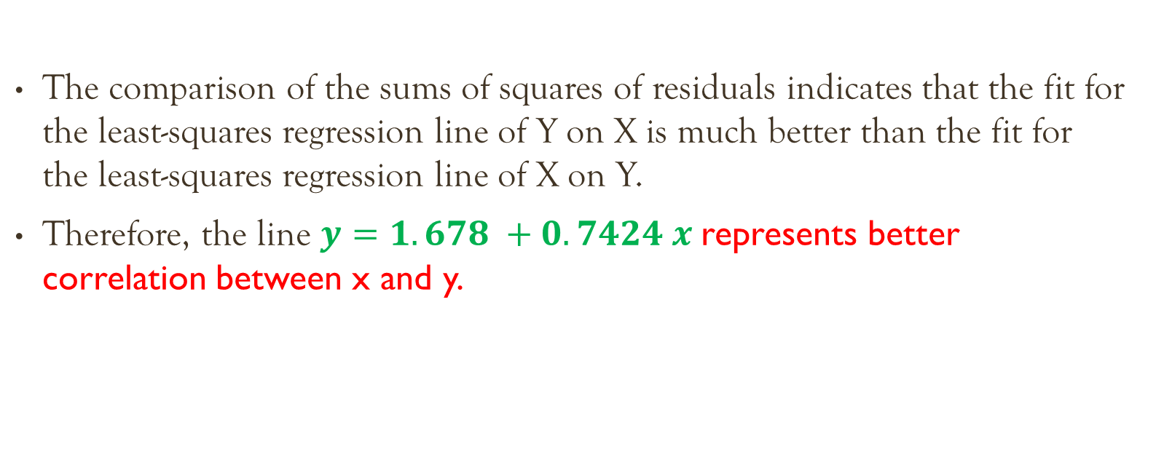
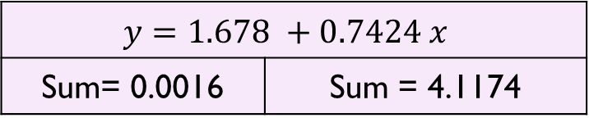
Cont..
$$y=1.678 +0.7424 x$$
Sum= 0.0016 | Sum = 4.1174
$$x=−1.7642 +1.2747 y$$
Sum= 0.0326 | Sum= 7.0701
The comparison of the sums of squares of residuals indicates that the fit for the least-squares regression line of Y on X is much better than the fit for the least-squares regression line of X on Y.
Therefore, the line $y=1.678 +0.7424 x$represents better correlation between x and y.

Slide 7
Question
Consider following data
Regression line of y on x is- y = -0.3333 + 0.7143 x
Regression line of x on y is- x= 1 + 1.2857 y
Determine which line is more correlated with all points with the help of residuals.
X | 3 | 5 | 6 | 8 | 9 | 11
Y | 2 | 3 | 4 | 6 | 5 | 8

Slide 8
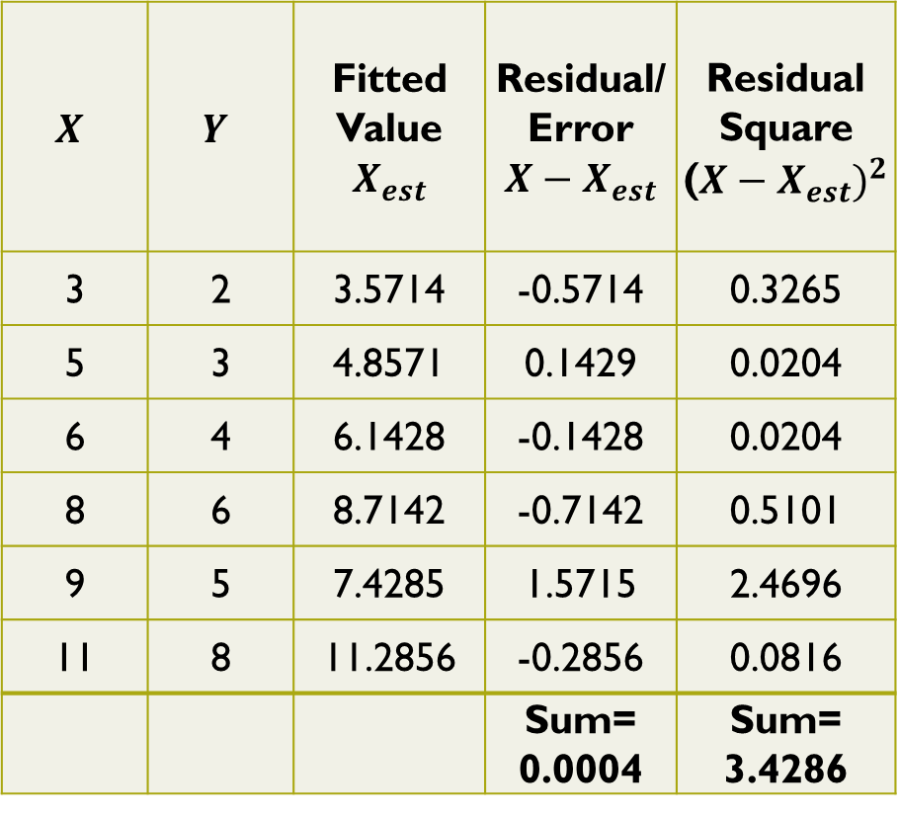
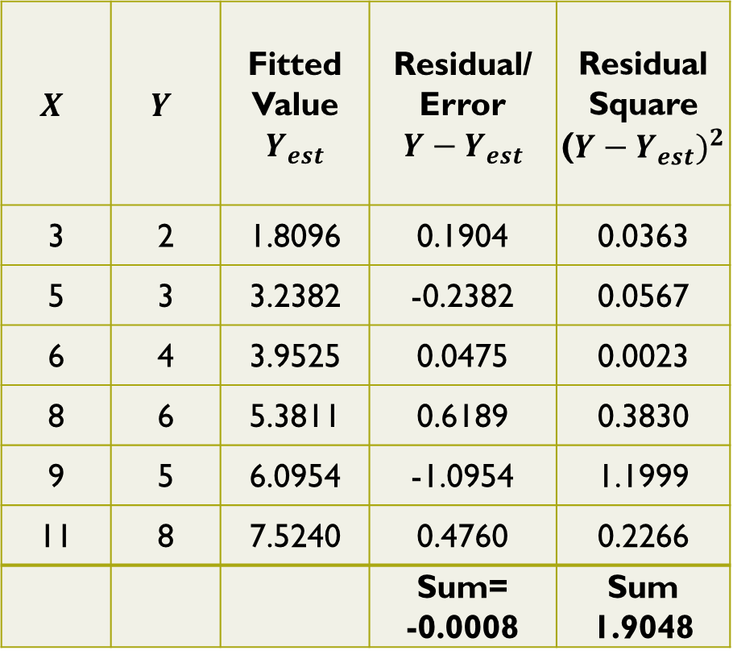
$$X$$ | $$Y$$ | Fitted Value $$Y_{est}$$ | Residual/ Error $$Y−Y_{est}$$ | Residual Square (${Y−Y_{est})}^{2}$
3 | 2 | 1.8096 | 0.1904 | 0.0363
5 | 3 | 3.2382 | -0.2382 | 0.0567
6 | 4 | 3.9525 | 0.0475 | 0.0023
8 | 6 | 5.3811 | 0.6189 | 0.3830
9 | 5 | 6.0954 | -1.0954 | 1.1999
11 | 8 | 7.5240 | 0.4760 | 0.2266
 |  |  | Sum= -0.0008 | Sum 1.9048
$$X$$ | $$Y$$ | Fitted Value $$X_{est}$$ | Residual/ Error $$X−X_{est}$$ | Residual Square (${X−X_{est})}^{2}$
3 | 2 | 3.5714 | -0.5714 | 0.3265
5 | 3 | 4.8571 | 0.1429 | 0.0204
6 | 4 | 6.1428 | -0.1428 | 0.0204
8 | 6 | 8.7142 | -0.7142 | 0.5101
9 | 5 | 7.4285 | 1.5715 | 2.4696
11 | 8 | 11.2856 | -0.2856 | 0.0816
 |  |  | Sum= 0.0004 | Sum= 3.4286
Therefore, the line y = -0.3333 + 0.7143 x represents better correlation between x and y.

Slide 9
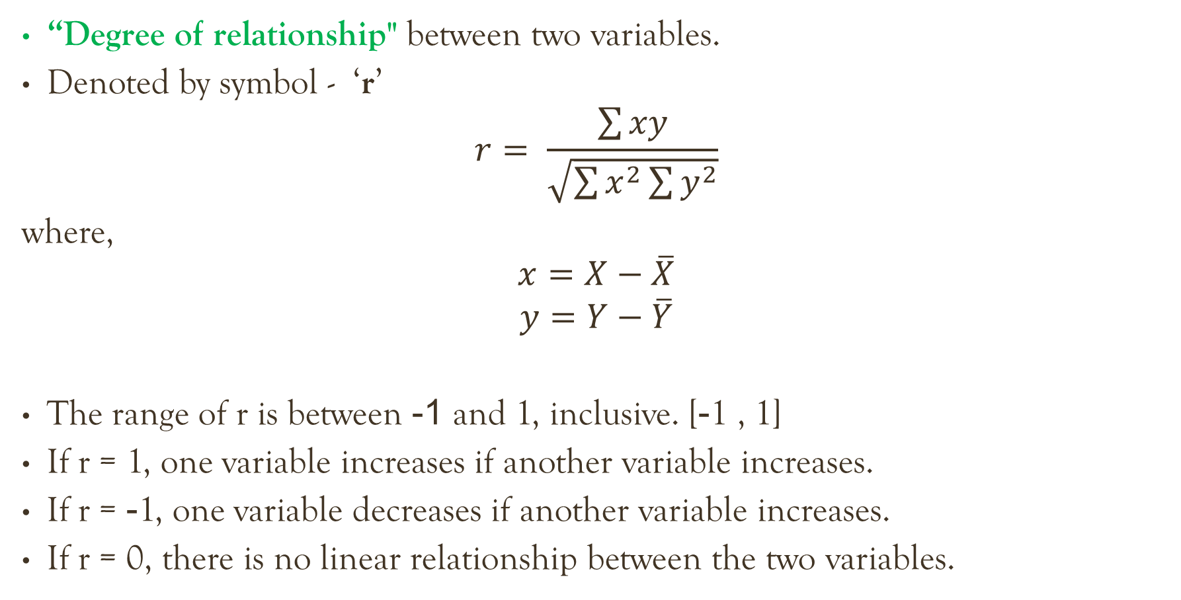
Coefficient of correlation
“Degree of relationship" between two variables.
Denoted by symbol - ‘r’
$$r= \frac{\sum{xy}}{\sqrt{\sum{x^{2}}\sum{y^{2}}}}$$
where,
$$x=X−\overline{X}$$
$$y=Y−\overline{Y}$$
The range of r is between -1 and 1, inclusive. [-1 , 1]
If r = 1, one variable increases if another variable increases.
If r = -1, one variable decreases if another variable increases.
If r = 0, there is no linear relationship between the two variables.

Slide 10
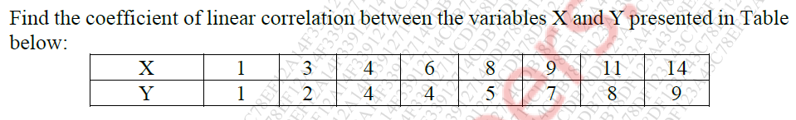

Question
Formula-
$$r= \frac{\sum{xy}}{\sqrt{\sum{x^{2}}\sum{y^{2}}}}$$
where,
$$x=X−\overline{X}$$
$$y=Y−\overline{Y}$$

Slide 11
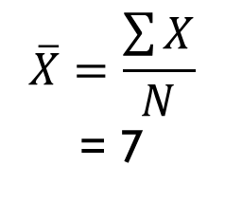
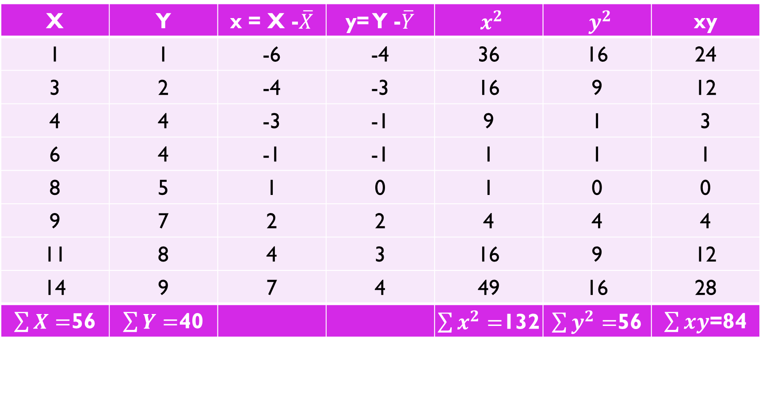
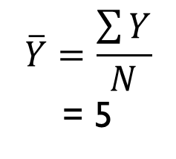
Solution
X | Y | x = X -$\overline{X}$ | y= Y -$\overline{Y}$ | $x^{2}$ | $y^{2}$ | xy
1 | 1 | -6 | -4 | 36 | 16 | 24
3 | 2 | -4 | -3 | 16 | 9 | 12
4 | 4 | -3 | -1 | 9 | 1 | 3
6 | 4 | -1 | -1 | 1 | 1 | 1
8 | 5 | 1 | 0 | 1 | 0 | 0
9 | 7 | 2 | 2 | 4 | 4 | 4
11 | 8 | 4 | 3 | 16 | 9 | 12
14 | 9 | 7 | 4 | 49 | 16 | 28
$\sum{X}=$56 | $\sum{Y}=$40 |  |  | $\sum{x^{2}=}$132 | $\sum{y^{2}=}$56 | $\sum{xy}$=84
$$\overline{X}=\frac{\sum{X}}{N}$$
= 7
$$\overline{Y}=\frac{\sum{Y}}{N}$$
= 5

Slide 12
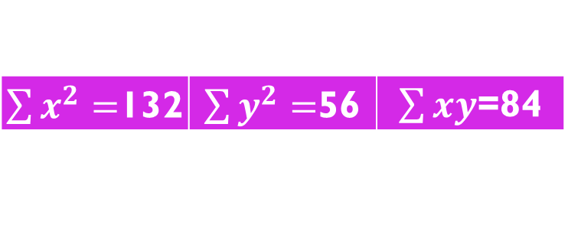

Cont..
Substitute all values in the formula-
$\sum{x^{2}=}$132 | $\sum{y^{2}=}$56 | $\sum{xy}$=84
$$r= \frac{\sum{xy}}{\sqrt{\sum{x^{2}}\sum{y^{2}}}}$$
r = $\frac{84}{\sqrt{132∗56}}$
r = 0.977

